Slide 1
Lecture 1b
Networking: The Big Picture

Slide 2
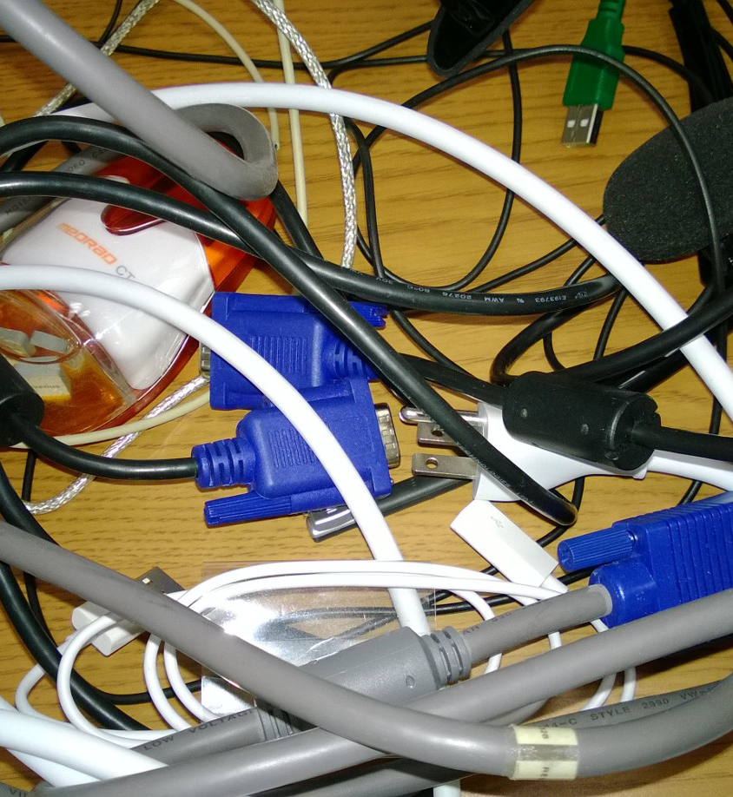
Tangled and Intricate
Grasping the details of networking is not simple
There are too many terms, acronyms, concepts, ideas, relations, similarities, differences
We will start slowly and build up our understanding

Slide 3
What we will do today
Look at a few examples, that have similarities and differences
Idea is to provoke some thoughts and questions about how networks of today operate
What needs to be in place to allow applications, devices, and humans to communicate?
What problems can we anticipate?
What quantitative metrics should we consider to evaluate the “performance” of networks?

Slide 4
Big Picture
Alice wants to send a greeting card to her grandmother. How does this work?
Alice wants to call Bob using (gasp!) the landline. How does this work?
Alice wants to browse Amazon.com to buy a book. What needs to happen to make this work?

Slide 5
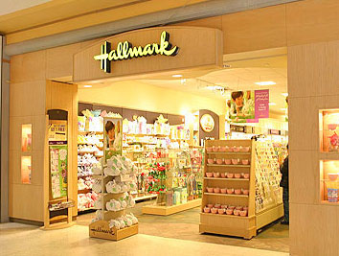


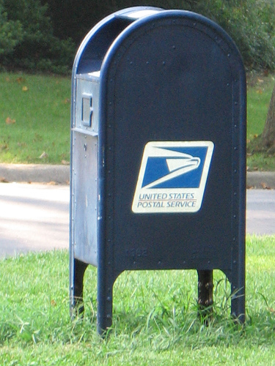
Sending a Greeting Card (1)
Goes to store, gets card
Content comes from here
Alice
Writes card for Grandma
May have special terms for grandma
Calls Mom for address!
Grandma doesn’t have e-mail or facebook!
Standard Vs Non-standard sizes matter
Fixes stamp, Drives
Mails card

Slide 6
Sending a Greeting Card (2)
Truck picks up the mail from mail box
Also get’s other mail from other folks
Mail goes to “sorting facility”
Mail to the same zip code go together
Mail is flown to destination
Perhaps trucked to destination post-office
Mail is sorted by route and delivered by mailman (delivery van)
Grandma picks up mail, opens greeting card first while discarding junk mail
See: http://en.wikipedia.org/wiki/United_States_Postal_Service for details

Slide 7
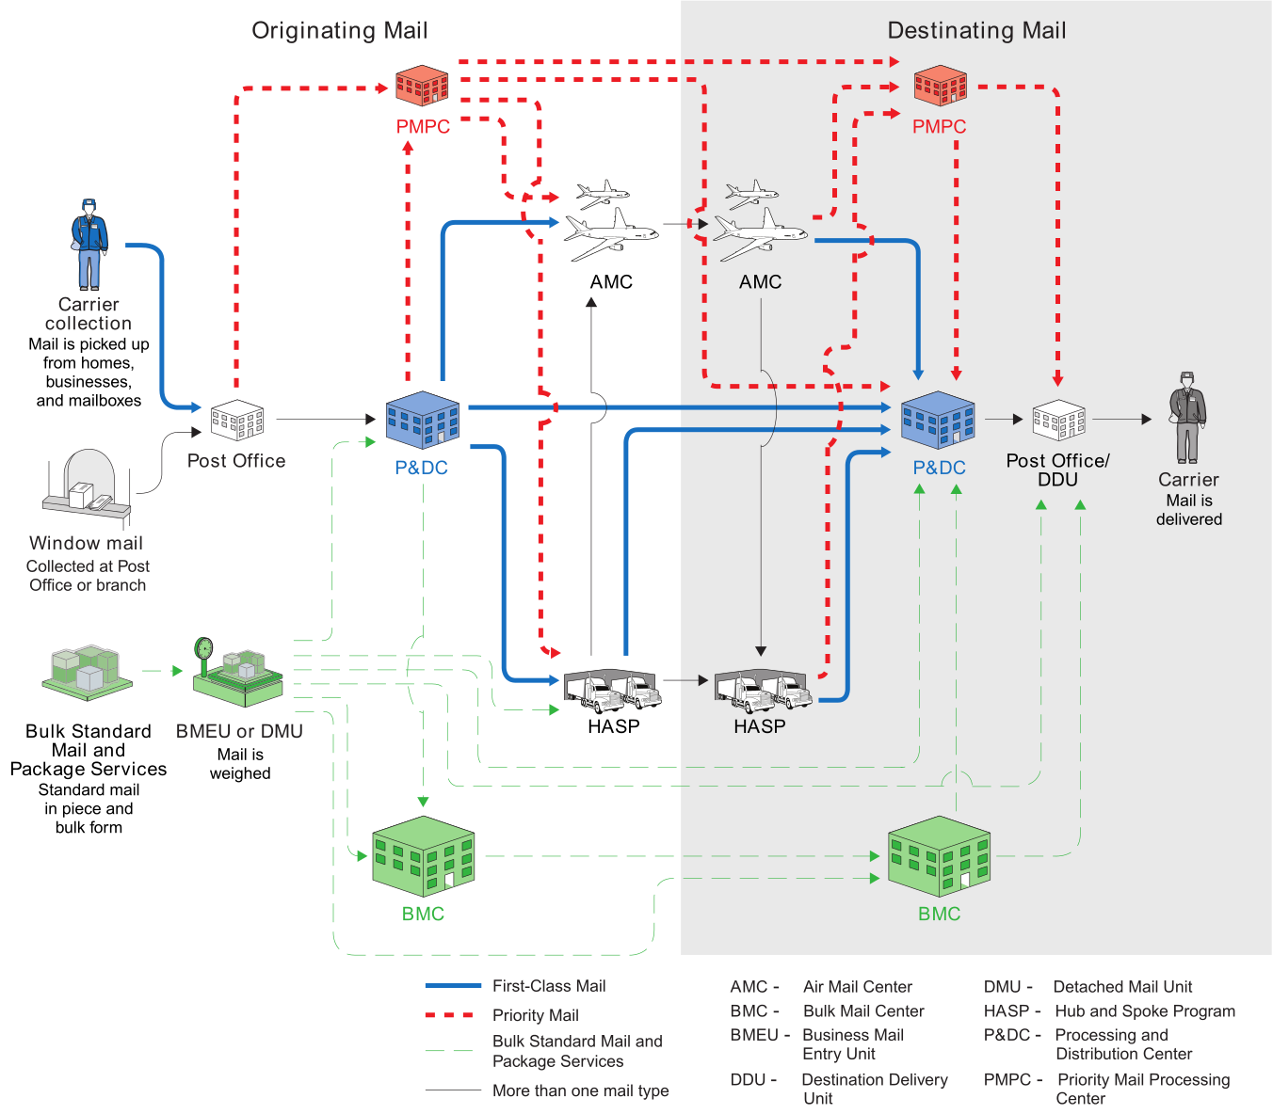
Source: http://upload.wikimedia.org/wikipedia/commons/e/e7/USPS_mail_flow_through_national_infrastructure.svg

Slide 8

Things to note
Acronyms! – It is a matter of language
There are different transportation methods
Cars, trucks, airplanes, delivery vans
Differences: Drop-off and Delivery Versus Sorting and Routing
There are different types of packages
Large, medium, small boxes
There are different types of services
First-class, bulk, certified, express, priority
Addressing and envelope are important
Follows a standardized format
Alice had to find the address!

Slide 9
Things to note (2)
Recall UPS’s delayed Christmas deliveries
Bottleneck due to limited capacity (number of flights)
Read articles
What if UPS had leased twice the number of aircrafts? Would they all be utilized?
Toys Vs perishable goods (QoS)
Bottlenecks can occur in many places due to many reasons
Weather, trucks, flights, people, machines, sorting, …

Slide 10
Big Picture
Alice wants to send a greeting card to her grandmother. How does this work?
Alice wants to call Bob using (gasp!) the landline. How does this work?
Alice wants to browse Amazon.com to buy a book. What needs to happen to make this work?

Slide 11

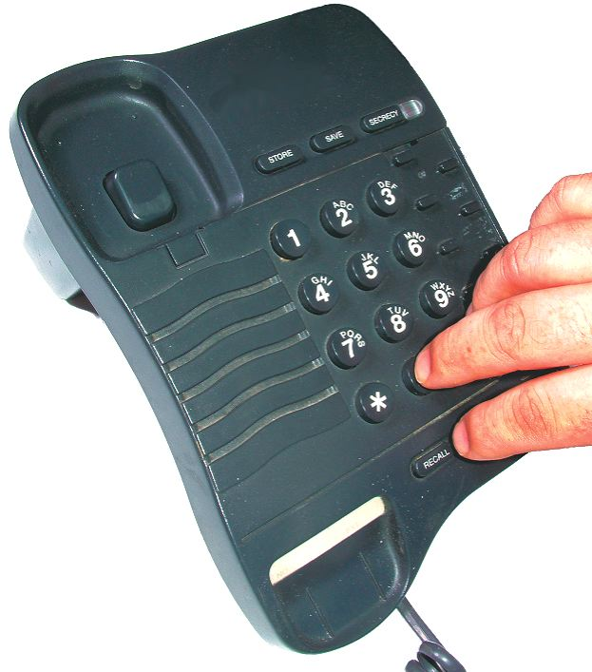
Voice Call on Land-line (1)
Looks up her contacts for
Mom’s phone number
“Address” here is the phone number
Alice
Lifts the phone, gets
dial-tone
Dial-tone indicates phone is working
Dials the phone number
for her mom
Dialing the number tells the “network” who should be reached
Rring
“Ring” tell’s Alice that her Mom’s phone may be ringing
Hears the phone “ring”

Slide 12

Source: http://madebyjoel.com/wp-content/uploads/2010/04/Made-by-Joel-Tin-Can-Phones-2.jpg

Slide 13
Voice-Call on Land-line (2) (simplified)
Slide modified from those provided by the author of the textbook
To Inter-exchange Carrier
Alice
OR Central Office
A dedicated “circuit” is set up from the IXC to Alice’s Mom
Dedicated line to Alice

Slide 14
Voice Call on Landline (3)
The “trunk” from the central office to the Inter-exchange Carrier “multiplexes” many voice calls
Compare with many pieces of mail and packages to the same state being flown over a plane
“Resources” are dedicated to a voice call
It appears as if there is an exclusive “wire” between Alice’s phone and her grandmother’s phone
The “wire” is created by “switches” in the phone network using the phone number
It takes time to set up the call
Such a connection is called “Circuit Switched”
We will revisit “switching” later

Slide 15

Circuit switched voice call (simplified)
Alice
IXC-A’s Network
Circuit
IXC – A’s
POP
IXC – A’s
POP
Central
Office
Tandem
Office
Central
Office
Tandem
Office
…
Central
Office
…
IXC – B’s POP
IXC – B’s POP
IXC-B’s Network
POP = Point of Presence

Slide 16
Big Picture
Alice wants to send a greeting card to her grandmother. How does this work?
Alice wants to call Bob using (gasp!) the landline. How does this work?
Alice wants to browse Amazon.com to buy a book. What needs to happen to make this work?

Slide 17
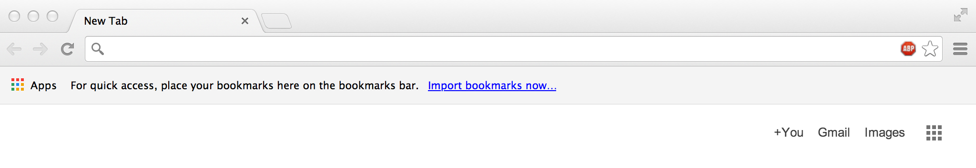
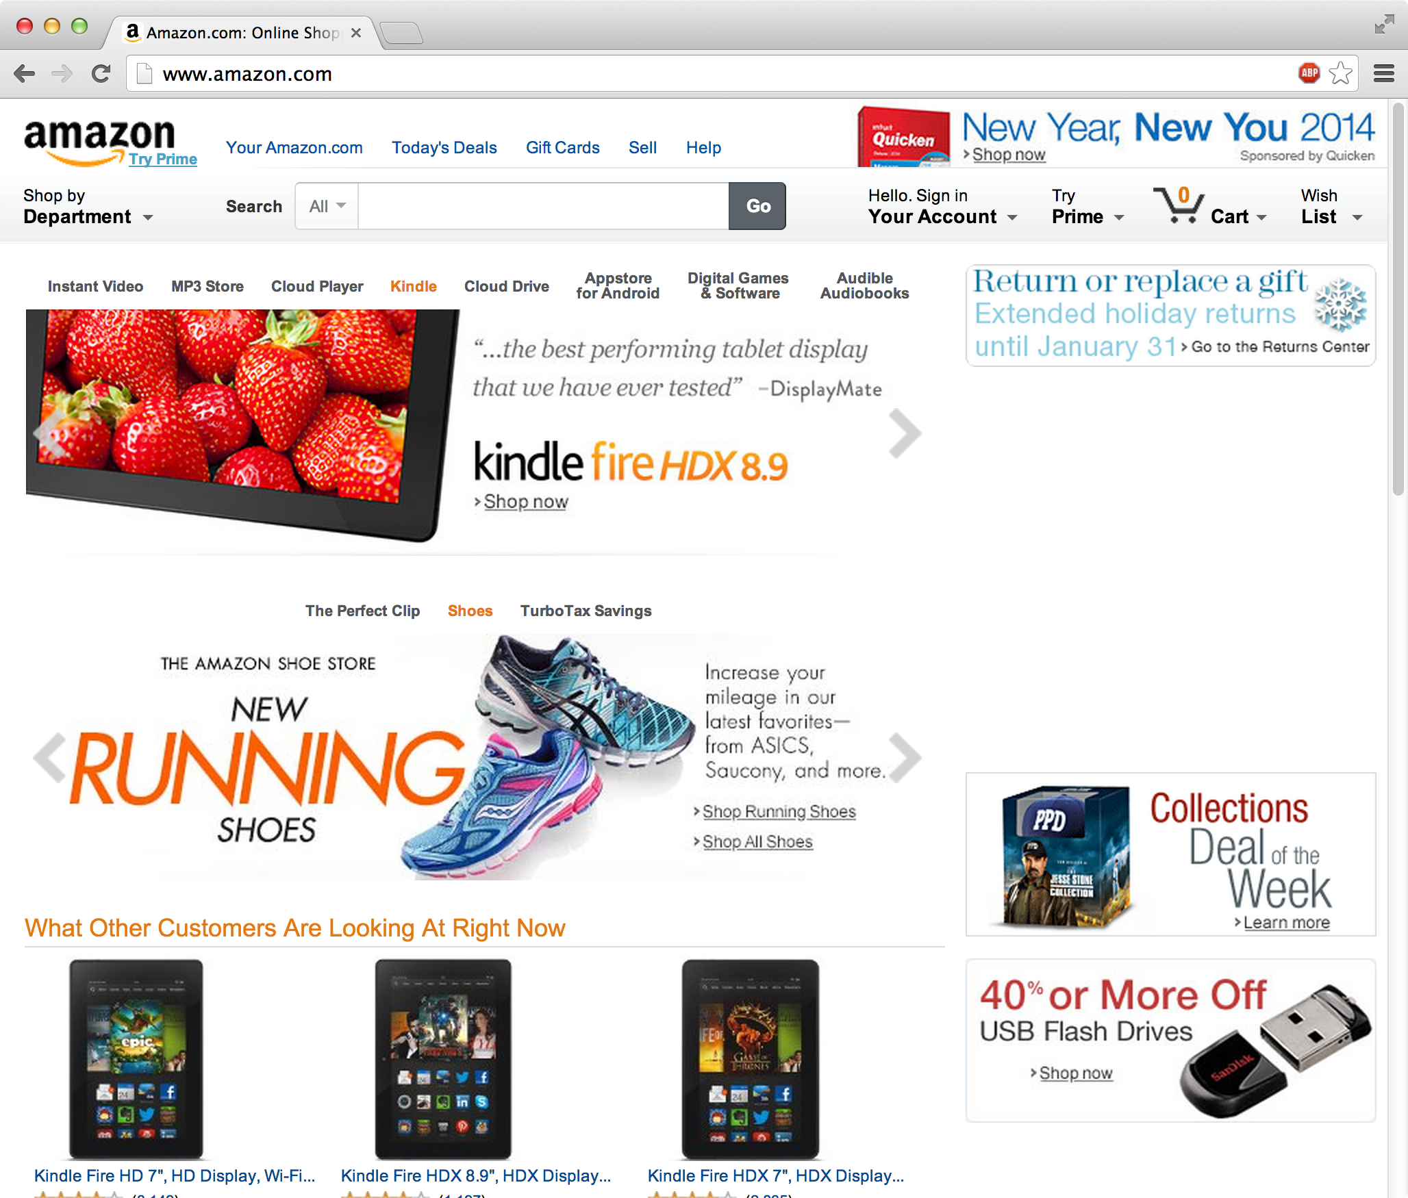
Browsing Amazon.com (1)
Boots her computer and
Opens browser
Browser is called the “client” software
Alice
“www.amazon.com” is the identity of “server”(s)
Types
http://www.amazon.com
Browser “loads” page
Is this magic??

Slide 18
Questions
How does the browser know what and where amazon.com is?
How does it “communicate” with amazon.com?
How is it connected to the Internet?
What if Alice is also browsing cnn.com at the “same” time?
How does the browser know if it has received the elements of the html page correctly?

Slide 19
Slide modified from Agrawal
“Packet switching” – to be revisited

Slide 20
What is a Communications Network?
A system of interconnected devices and the underlying infrastructure that enable the exchange of electronic information (analog or digital)
Components
Electronic communication devices
PCs, phones, tablets, sensors, laptops, servers, etc.
Network Devices
Hubs, routers, cross-connects, base stations, firewalls, databases, name servers, etc.
Communication links
Coaxial cable, twisted pair cable, wireless, etc.
Services
Phone calls, video, web, software applications, etc.

Slide 21
Networks are part of IT infrastructure
Information Technology (IT) or Information and Communications Technology (ICT) infrastructure components
Computational end/user devices
Networks
Telephone networks (wired and wireless)
Internet and access networks (wired and wireless)
Satellites
Links
Heterogeneous components/technology
Variety of services provided
Web, voice, video, SCADA, email, SMS
Compare with package sizes and content with postal service

Slide 22
Computational/User Devices
Continuum
Sensors/embedded controller
Handhelds (tablets, cellphones)
PCs/Workstations
High data rate sensors (e.g., radar)
Video cameras
Servers
Databases
Etc.
Heterogeneous devices
Features, Functions, OS platforms different
Security vulnerabilities and capabilities differ

Slide 23



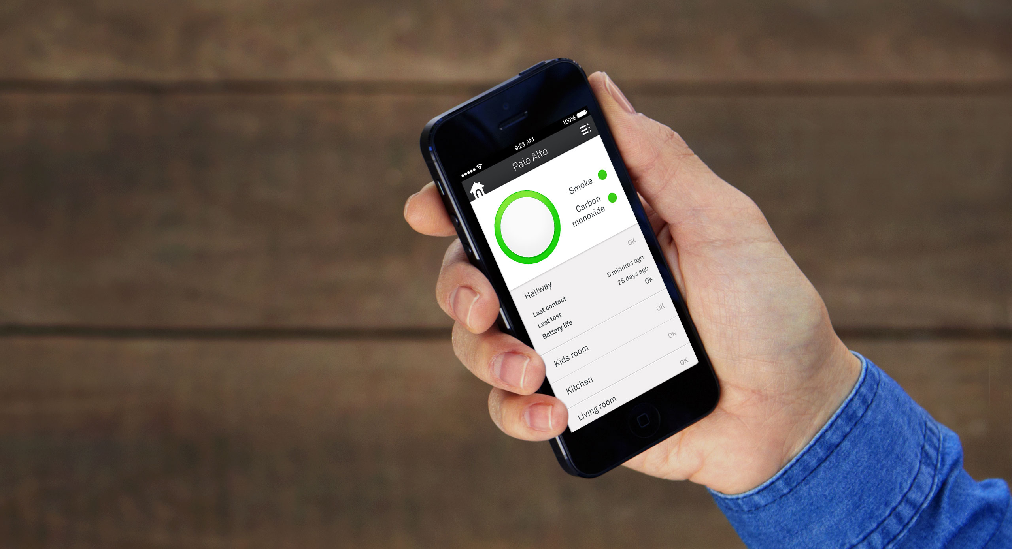
Internet of “everything”
The Philips “Hue”
The Nest “Protect”

Slide 24
Types of Networks – One Classification
Based on geographical size
Access Networks
LANs, Campus, Residential networks, etc.
Metropolitan Networks (Metro Nets)
Interconnection of central offices, POPs, corporate locations in a city, campus backbone network
Higher bandwidth, may include leased communication links
Wide Area Networks (WANs) or Long Haul Networks
Private and Public Backbone networks (Level3, AT&T)
Content Delivery Networks (Akamai)
Corporate virtual private network over common infrastructure
Mail delivery
Local loop for landline call

Slide 25
Yet another analogy: Airline inter-hub
A traveler from West Chester, PA needs to visit Naples, Italy.
An airport shuttle collects people going to the airport
A regional “commuter” jet brings him/her to JFK airport in New York City
At NYC, people from all over East Coast board a well-filled 747 non-stop flight to Rome, Italy
From Rome, a regional jet takes traveler to Naples
Airport shuttle drops travelers at their hotels in Naples
Pattern:
Access - Transport - Access
An optical fiber wavelength is the “747” (long-haul)
Multiplexing in the access and metro transport stages (switches, routers) are the regional airlines
Efficient solutions in airlines, shipping, and telecommunications industry all have this basic repeated structure

Slide 26
Typical Wired Network Structure
Current Trends
Core ~ Mesh
Metro ~ Ring
Access ~ Tree
Metro Area 1
Metro Area 2
Access
Feeder Network
Backbone or Core
Metro Area 3
Central Offices
Metro Area N

Slide 27
Network Types Again
Networks have varying technology, components and protocols depending on size!
WAN: Cross connects, routers, etc, DWDM, MPLS, IP, etc, SIP, BGP, OSPF etc,
METRO: SONET, ATM, MPLS, Carrier Ethernet, Frame Relay, WiMAX, point to point microwave, free space optical, etc
ACCESS: Twisted pair, T1, DSL, Cable Modem, WLAN, cellular, Fiber to Curb , Ethernet, etc.
Notes:
You all know what public networks look like. There is the access network, the metropolitan network, and the long haul networks. We are mostly focused on long-haul networks: Composed of very long fibre routes on which fibre cuts can be quite frequent. Also, the amount of traffic carried by these fibres is very high and therefore survivable is a big concern.

Slide 28
Wireless Networks
Wireless Networks have another set of technologies and protocols!

Slide 29


Telecom and Networking Industry is Regulated!
Unlike other components of IT
Regulatory bodies have a hierarchy
International Telecommunications Union (ITU)
ITU is part of the United Nations
Worldwide coordination/ standardization (e.g., telephone numbers)
Allocation (e.g., satellite slots)
Federal Communications Commission (FCC) in the US
Regulates wireless spectrum (bands, licenses, power levels, etc,)
Long distance voice
Cable,
Satellite, etc.

Slide 30




Telecom and Networking Industry Standardization
Heavy emphasis on standardization (interoperability, $)
Standards bodies include
International Telecommunications Union
Optical networking, telephony, cellular
Internet Engineering Task Force (IETF)
Internet protocols and enhancements
Institute for Electrical and Electronic Engineers (IEEE)
Ethernet, 802.11 WiFi
European Telecommunications Standards Institute (ETSI)
GSM, DSL
3rd Generation Partnership Project (3GPP)
UMTS, LTE, LTE-Advanced

Slide 31
Enterprise Networking
Adopt an enterprise/business view of networking
Network/communication infrastructure enables distributed applications
Web, email, voice, instant messaging, video, e-commerce, file sharing, cloud computing, etc.
Referred to as “unified communications” today
Focus on communication services provided to apps
Connectivity and performance

Slide 32
Business Goals
Identify overall business goal of network
What will the network be used for? Mission critical uses?
How does the enterprise think the network will improve their business practices?
What is the criteria to be used to judge the network success/failure?
Typical business goals (may not be realistic!)
Increase revenue and profit
Shorten product development cycles/improve corporate communications
Provide new services/Modernize out-dated technologies
Reduce network costs
Make more data available to more people
Improve network security and reliability

Slide 33
Business Constraints
Organizational Politics and Policies
Who will manage/run network
What are the companies policy on suppliers, platforms, vendors etc.
Open vs. proprietary solutions?
Security issues
Budget and Staffing Constraints
Cost will often limit network options
Staff abilities may determine some of network choices
Outsourcing vs. In House?
Scheduling
Technical goal is to operate a network that meets users’ requirements + some they may not know they need.
Scalability
Availability
Network Performance
Utilization, Throughput, Delay
Delay Jitter Packet Loss Call blocking
Security
Manageability/Interoperability
Affordability $$

